Slide 1
SUBJECT NAME - 041 MATHEMATICS
an International CBSE Finger Print School Coimbatore
GRADE-XII
UNIT – 1
TOPIC – RELATIONS & FUNCTIONS

Slide 2
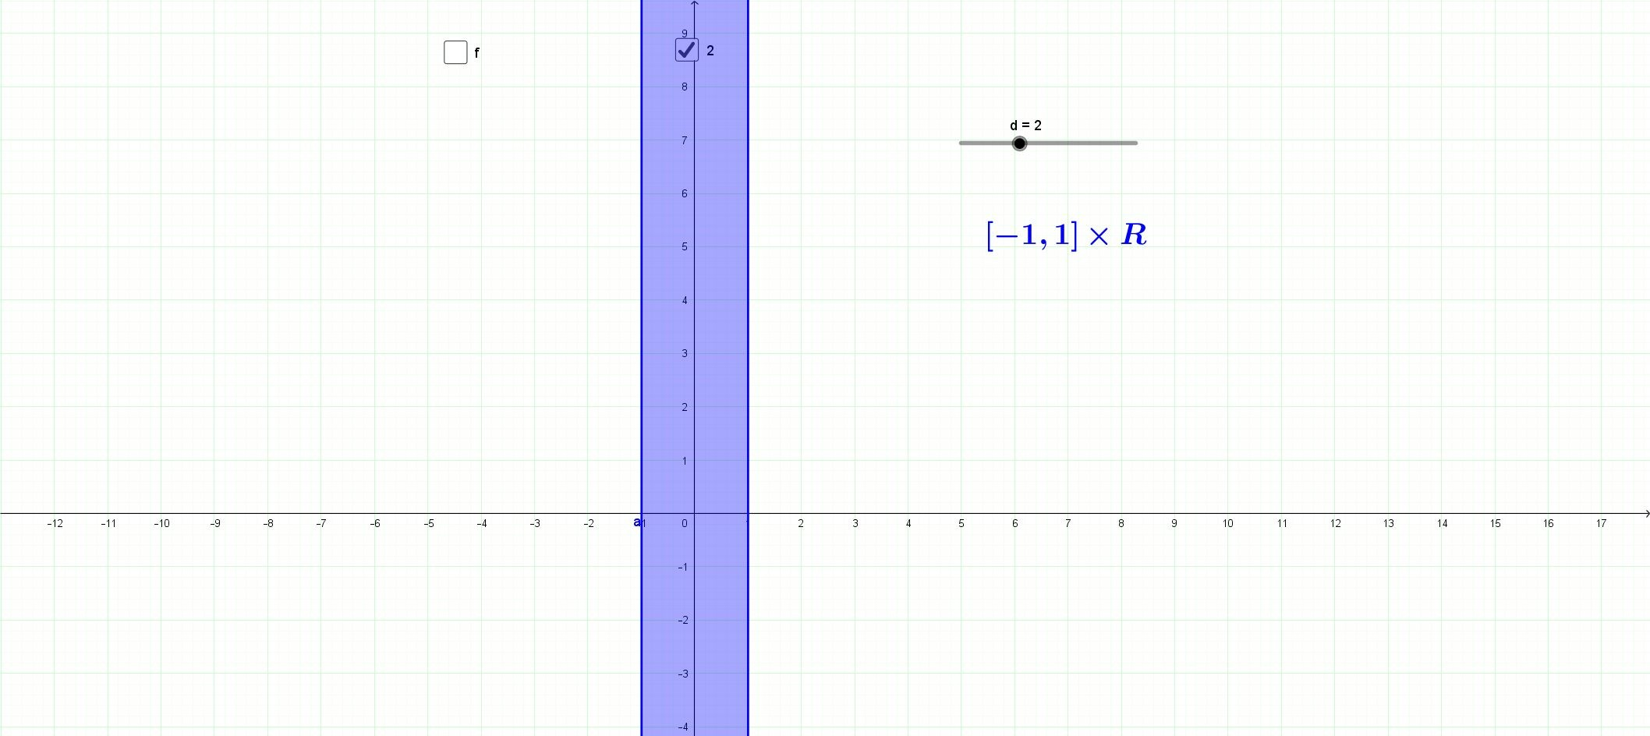
Relations & Functions
Cartesian Product of Sets

Slide 3
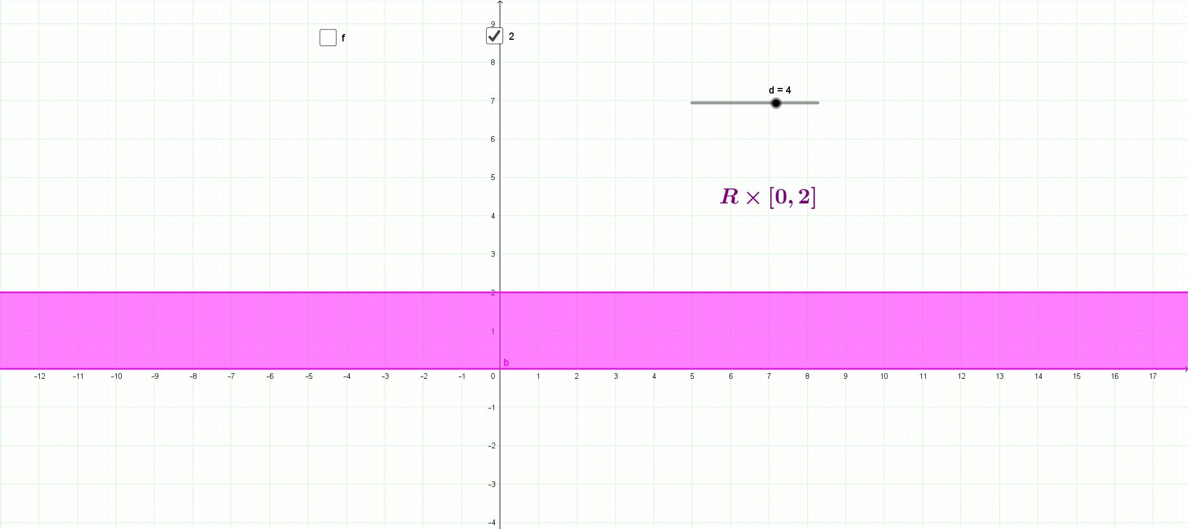
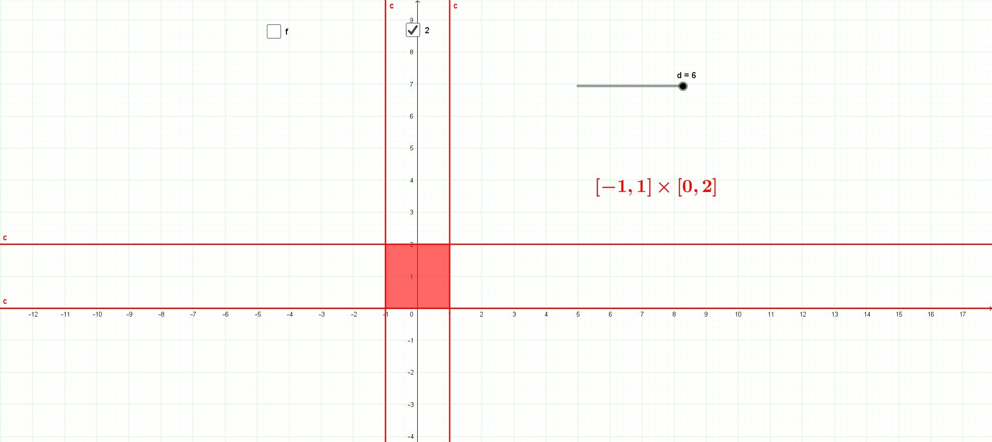

Slide 4
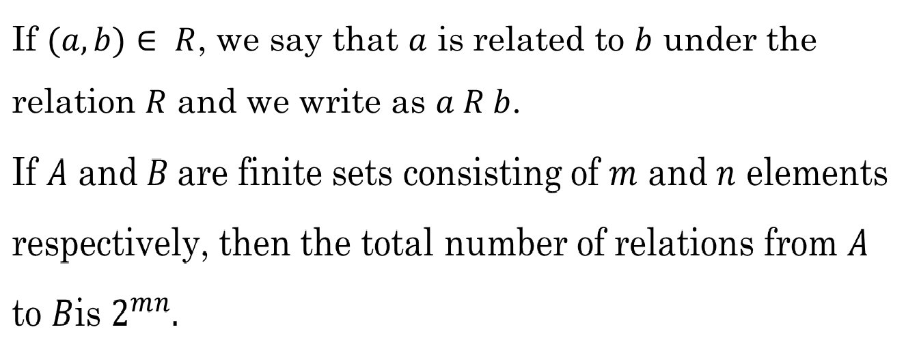
Relation

Slide 5
Domain of a Relation.
Range of Relation

Slide 6
Relation on a Set
Inverse of a Relation

Slide 7
Types of Relations
□ Void or Empty Relation
□ Universal Relation

Slide 8
□ Identity Relation

Slide 9
□ Reflexive Relation
Note: Every identity relation is Reflexive, but the converse is not true.
□ Symmetric Relation

Slide 10
□ Transitive Relation
□ Equivalence Relation

Slide 11
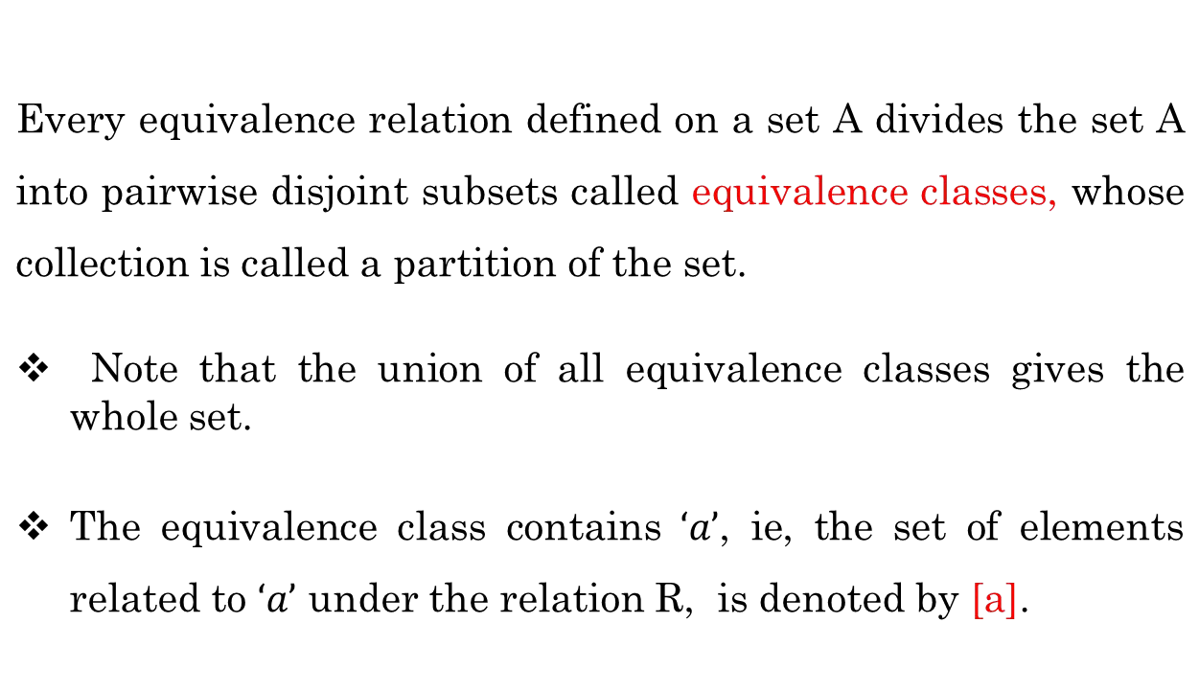
□ Equivalence Class.

Slide 12
Functions
Function as a set of ordered pairs.
Function as a correspondence

Slide 13
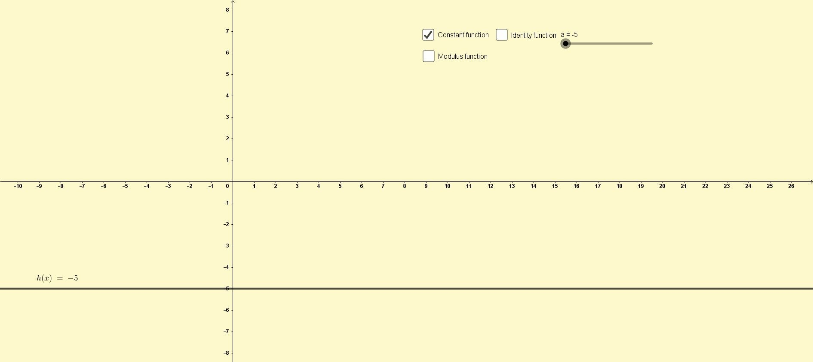
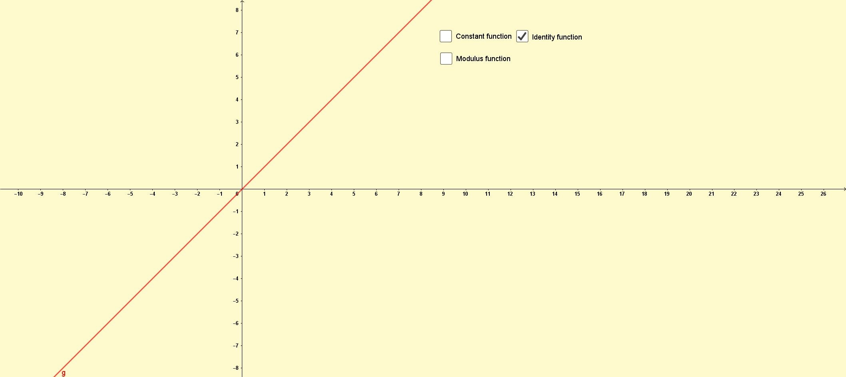
□ Constant function.
□ Identity function

Slide 14
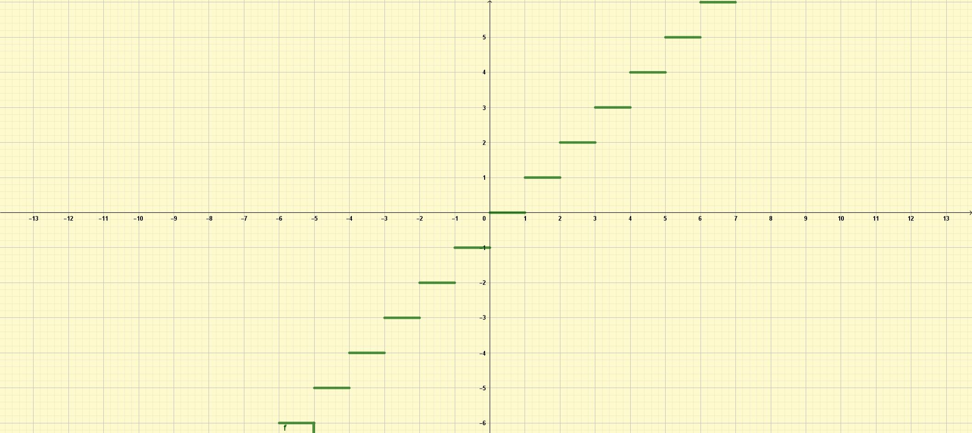
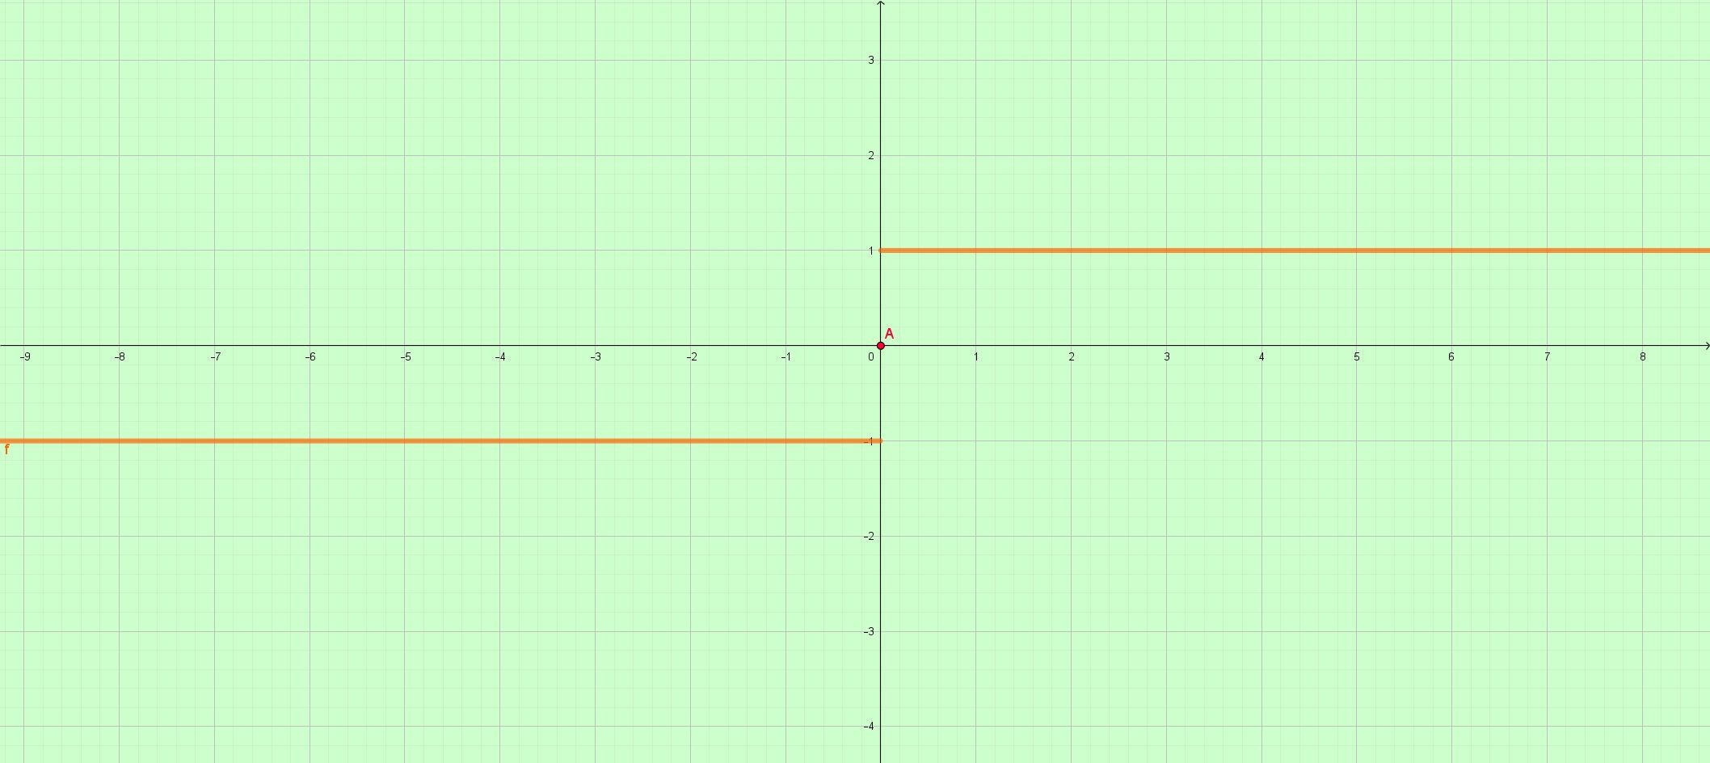
□ Greatest Integer Function
□ Signum Function

Slide 15
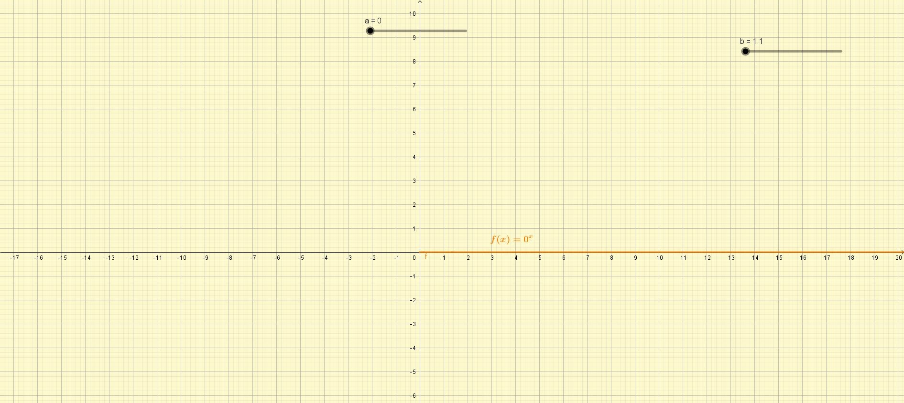
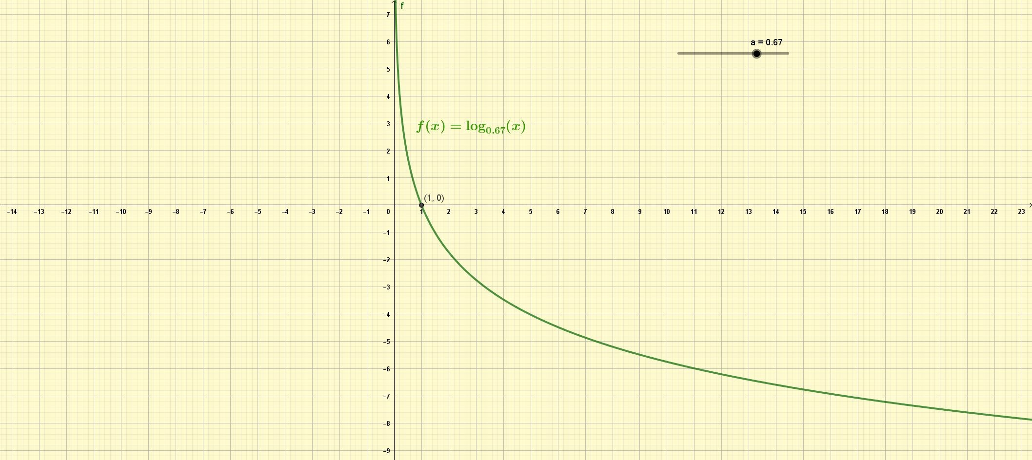
□ Exponential Function
□ Logarithmic Function

Slide 16
□ Even and Odd Functions
□ Equality of Functions

Slide 17
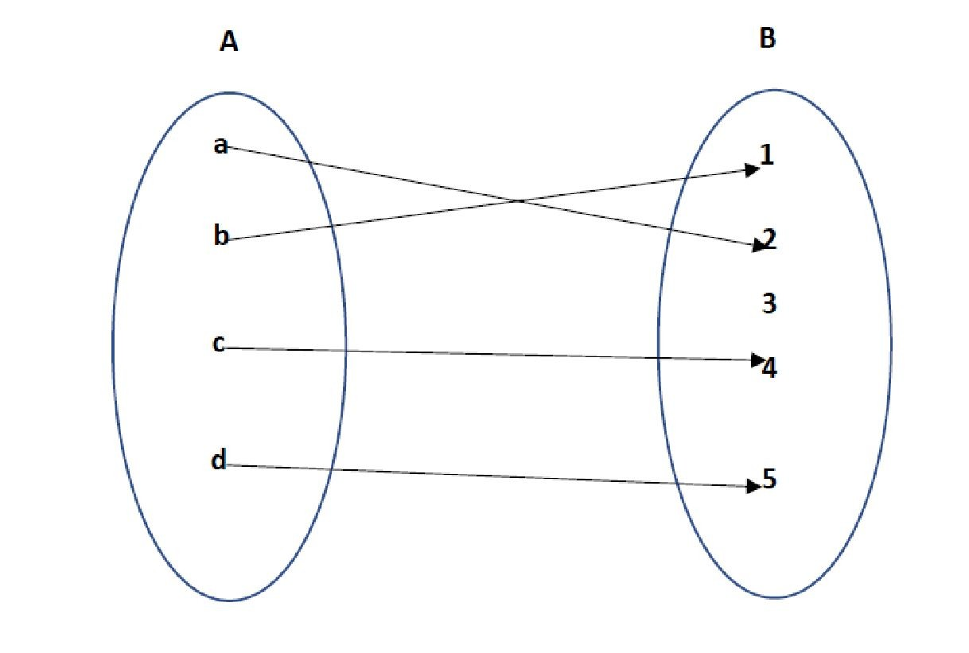
KINDS OF FUNCTIONS
□ One-One Function(Injection)
□ Many-one Function

Slide 18
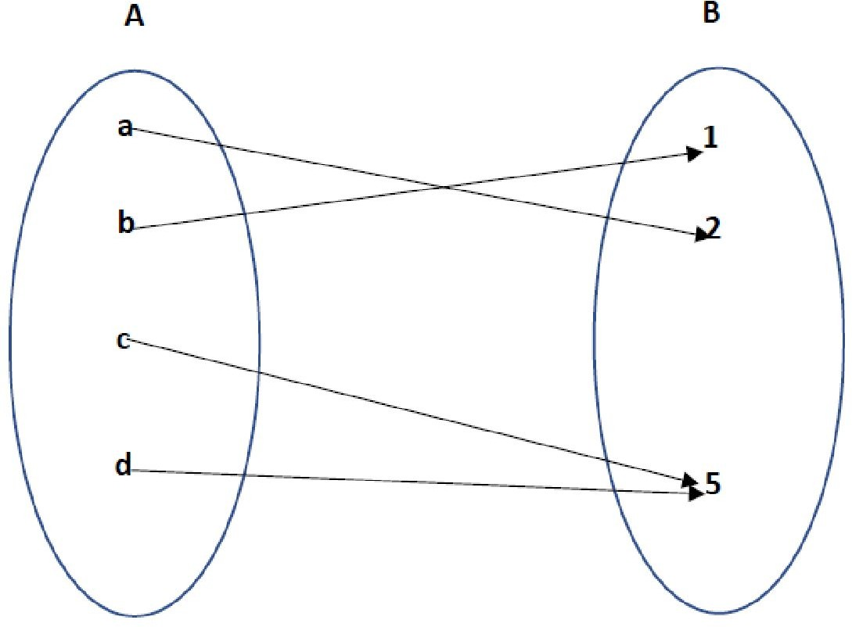
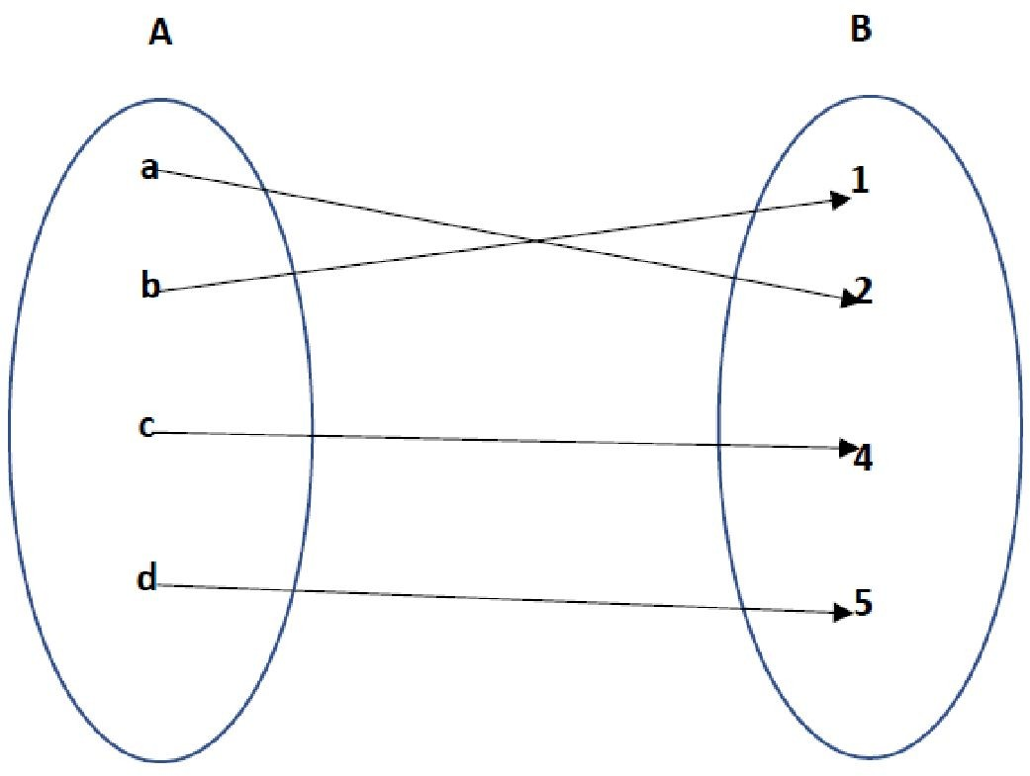
□ Onto Function (Surjection)

Slide 19
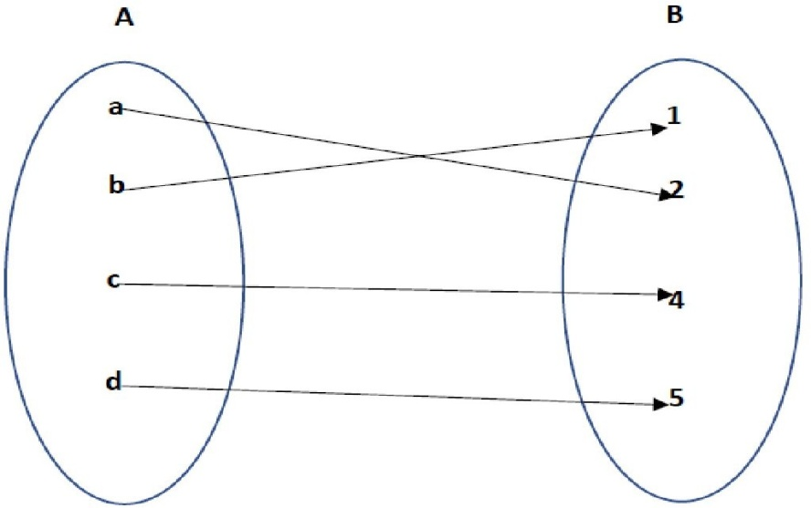
□ Into Function:
□ BIJECTION

Slide 20
Composition of Functions
g(f(x))
x
in
out
f(x)

Slide 21
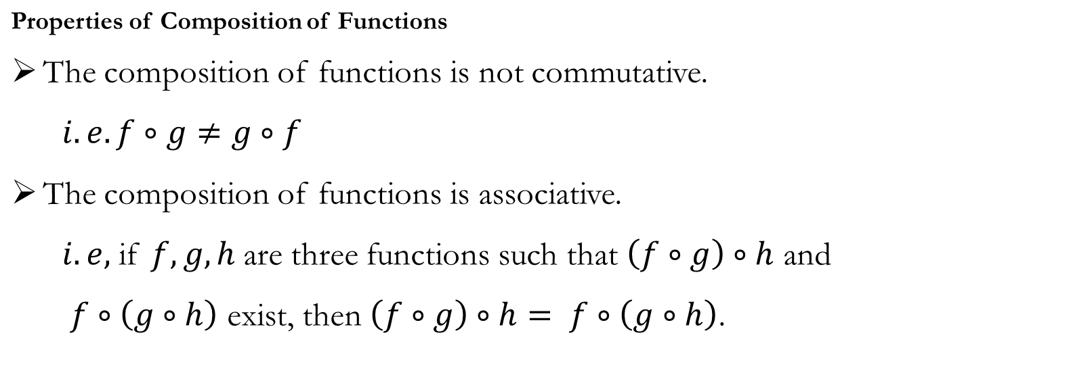

Slide 22
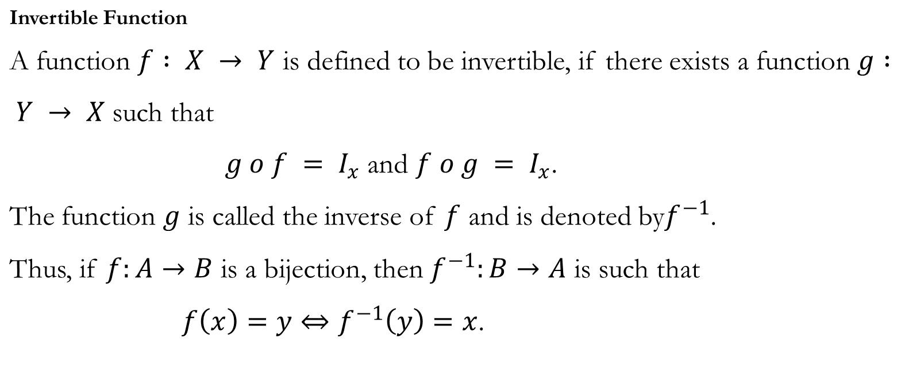

Slide 24
Questions:
Show that the relation R in the set R of real numbers, defined as R = {(a, b) : a ≤ b2} is neither reflexive nor symmetric nor transitive.
Show that the relation R in the set {1, 2, 3} given by R = {(1, 2), (2, 1)} is symmetric but neither reflexive nor transitive.
Let R be the relation in the set N given by R = {(a, b) : a = b – 2, b > 6}. Choose the correct answer. (A) (2, 4) ∈ R (B) (3, 8) ∈ R (C) (6, 8) ∈ R (D) (8, 7) ∈ R
Let A = {1, 2, 3}, B = {4, 5, 6, 7} and let f = {(1, 4), (2, 5), (3, 6)} be a function from A to B. Show that f is one-one.

Slide 25
References
https://www.slideshare.net/Dreams4school/relations-and-functions-42999445
https://studylib.net/doc/5711898/relations-and-functions--ppt-
https://gyansindhuclasses.com/wp-content/uploads/2021/11/Class-12-Relation-and-function-PPT.pdf
https://d2cyt36b7wnvt9.cloudfront.net/exams/wp-content/uploads/2019/12/06154032/Maths_Ch-01.pdf
https://www.tiwariacademy.com/ncert-solutions/class-12/maths/chapter-1/

